Slide 1

Course – Computer Organization and Architecture
Course Instructor
Dr. Umadevi V
Department of CSE, BMSCE

Slide 2
Unit-5
Some Fundamental Concepts, Fundamental Basic Processing Unit: Some Fundamental Concepts , Instruction Execution, Hardware Components, Instruction Fetch and Execution Steps, Control Signals, Hardwired Control
Parallel Computer Architecture: Processor Architecture and Technology Trends, Flynn’s Taxonomy of Parallel Architectures, Memory Organization of Parallel Computers: Computers with Distributed Memory Organization, Computers with Shared Memory Organization, Thread-Level Parallelism: Simultaneous Multithreading, Multicore Processors

Slide 3
Basic Processing Unit

Slide 4
Fundamental Concepts
Processor fetches one instruction at a time and perform the operation specified.
Instructions are fetched from successive memory locations until a branch or a jump instruction is encountered.
Processor keeps track of the address of the memory location containing the next instruction to be fetched using Program Counter (PC).
Instruction Register (IR)

Slide 5
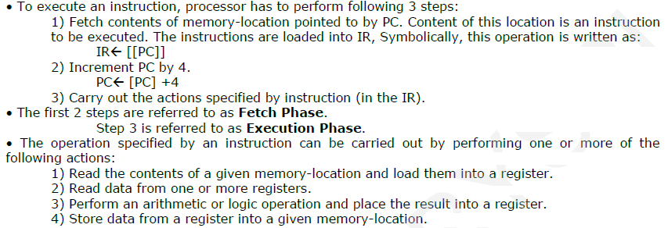
Fundamental Concepts (Contd…)

Slide 6
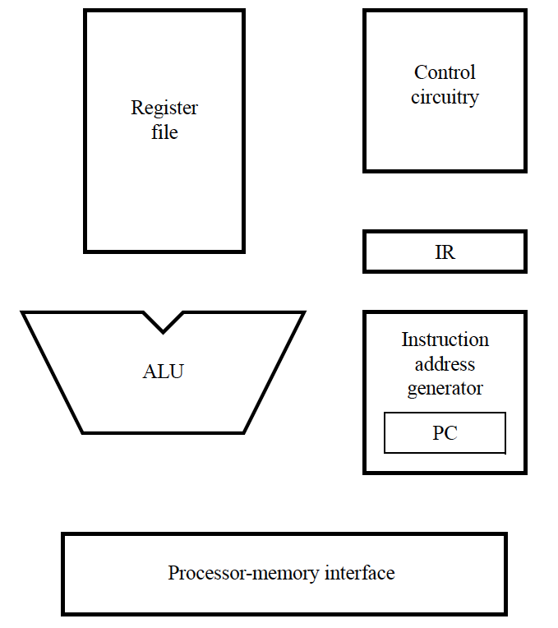
Fundamental Concepts (Contd…)
PC provides instruction address.
Instruction is fetched into IR
Instruction address generator updates PC
Control circuitry interprets instruction and generates control signals to perform the actions needed.
Main hardware components of a processor

Slide 7
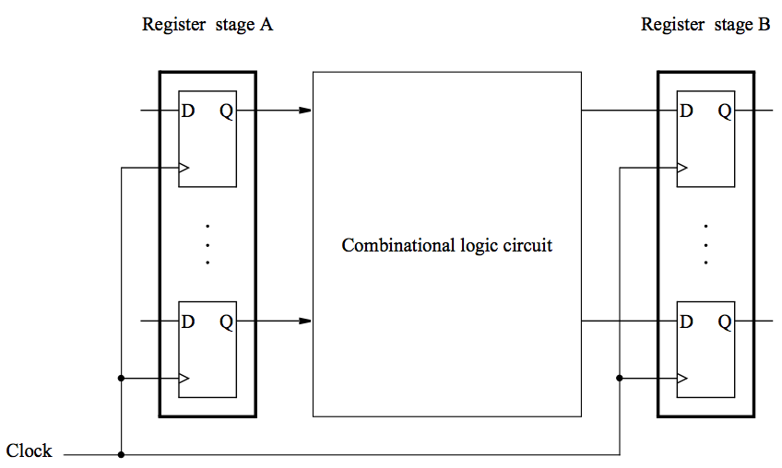
Data Processing Hardware
Contents of register A are processed and deposited in register B.
Basic structure for data processing

Slide 8
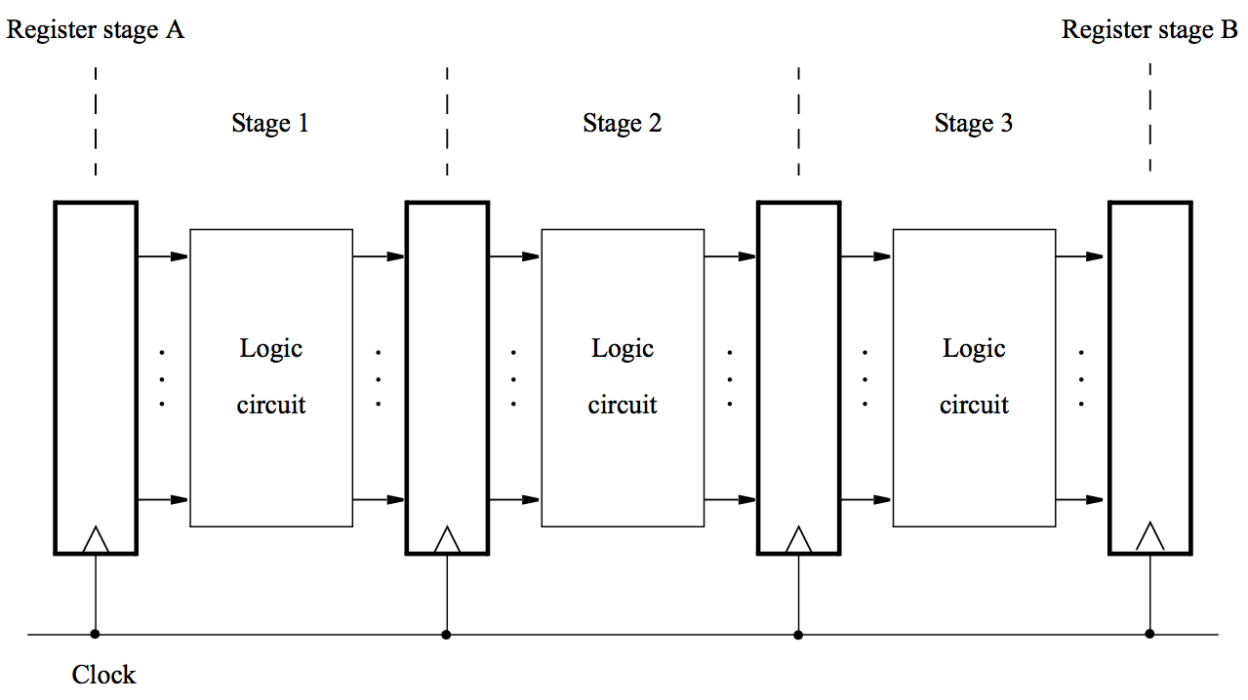
Data Processing Hardware (Contd…)
Processing moves from one stage to the next in each clock cycle.
Such a multi-stage system is known as a pipeline.
High-performance processors have a pipelined organization.
Pipelining enables the execution of successive instructions to be overlapped.
A hardware structure with multiple stages.

Slide 9
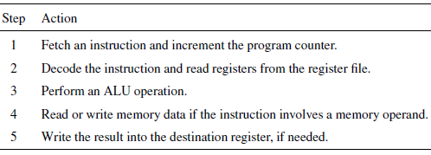
Five-step sequence of actions to fetch and execute an instruction.
A five-step sequence of actions to fetch and execute an instruction.

Slide 10
Instruction Execution
Load Instructions
Consider the instruction
Load R5, X(R7)
which uses the Index addressing mode to load a word of data from memory location X + [R7] into register R5.
Fetch and Execution of this instruction involves the following actions:
1. Fetch the instruction and increment the program counter.
2. Decode the instruction and read the contents of register R7 in the register file.
3. Compute the effective address.
4. Read the memory source operand.
5. Load the operand into the destination register, R5.

Slide 11
Instruction Execution (Contd…)
Arithmetic and Logic Instructions:
A typical instruction of this type is
Add R3, R4, R5
Fetch and Execution of this instruction involves the following actions:
1. Fetch the instruction and increment the program counter.
2. Decode the instruction and read registers R4 and R5.
3. Compute the sum [R4] + [R5].
4. No action.
5. Load the result into the destination register, R3.

Slide 12
Instruction Execution (Contd…)
Store Instruction
Store R6, X(R8)
stores the contents of register R6 into memory location X + [R8].
Fetch and Execution of this instruction involves the following actions:
1. Fetch the instruction and increment the program counter. 2. Decode the instruction and read registers R6 and R8.
3. Compute the effective address X + [R8].
4. Store the contents of register R6 into memory location X + [R8].
5. No action

Slide 13
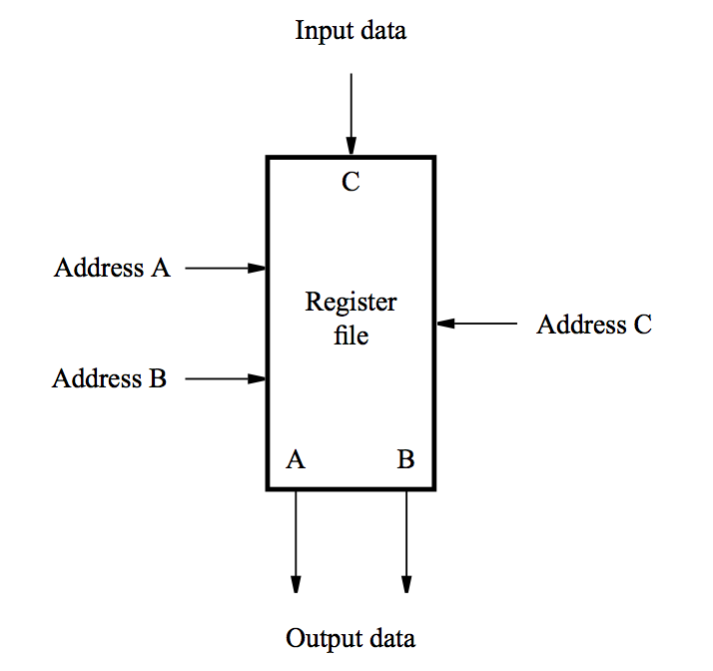
Hardware Components
The discussion in previous slides indicates that all instructions of a RISC-style processor can be executed using the five-step sequence. Hence, the processor hardware may be organized in five stages, such that each stage performs the actions needed in one of the steps.
Register File
A 2-port register file is needed to read the two source registers at the same time.
It may be implemented using a 2-port memory.

Slide 14
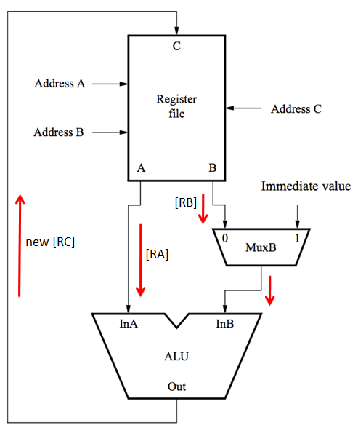
Hardware Components: ALU (Contd…)
- Two source operands are from registers.
Both source operands and the destination location are in the register file.
[RA] and [RB] denote values of registers that are identified by addresses A and B
new [RC] denotes the result that is stored to the register identified by address C
Conceptual view of the hardware needed for computation.

Slide 15
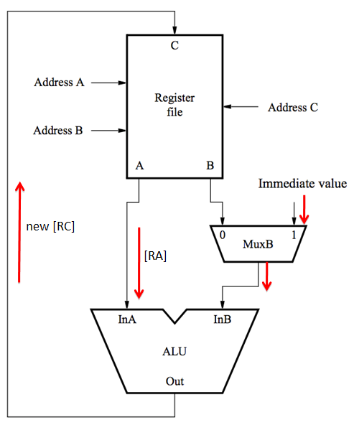
Hardware Components: ALU (Contd…)
- One of the source operands is the immediate value in the IR.
Conceptual view of the hardware needed for computation.

Slide 16
Five-step sequence of actions to fetch and execute an instruction.
A five-step sequence of actions to fetch and execute an instruction.

Slide 17
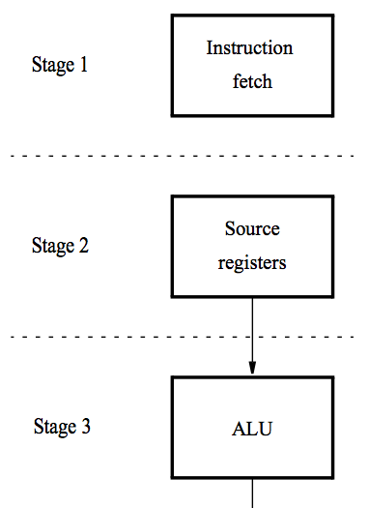
Hardware Components: DataPath
A five-stage organization
Instruction processing moves from stage to stage in every clock cycle, starting with fetch.
The instruction is decoded and the source registers are read in stage 2.
Computation takes place in the ALU in stage 3.

Slide 18
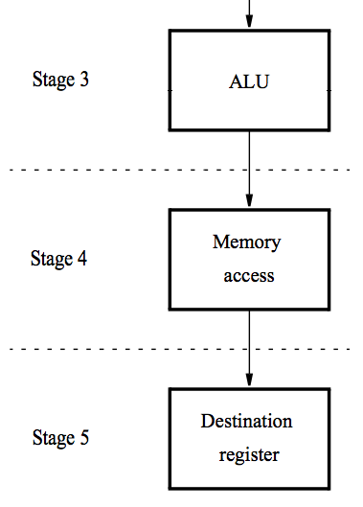
Hardware Components: DataPath
If a memory operation is involved, it takes place in stage 4.
The result of the instruction is stored in the destination register in stage 5.
A five-stage organization

Slide 19
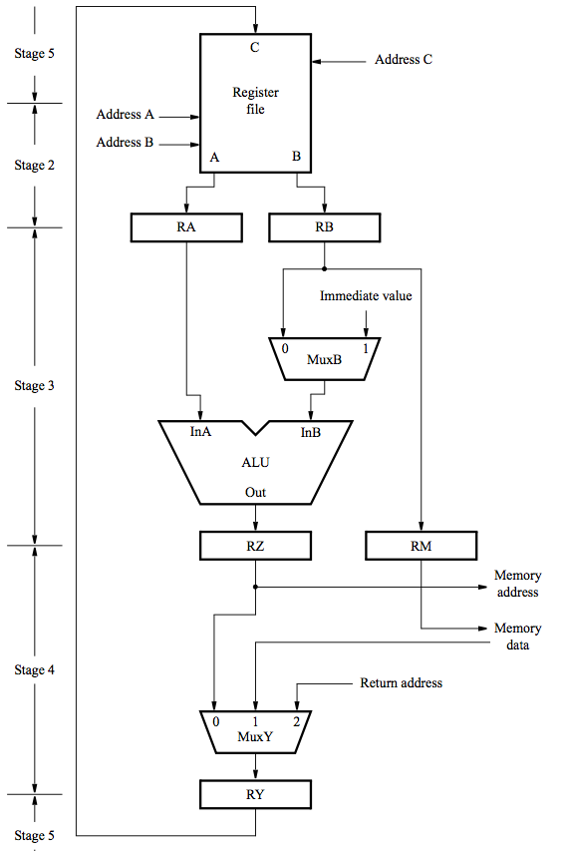
Hardware Components: DataPath
Datapath in
a processor

Slide 20
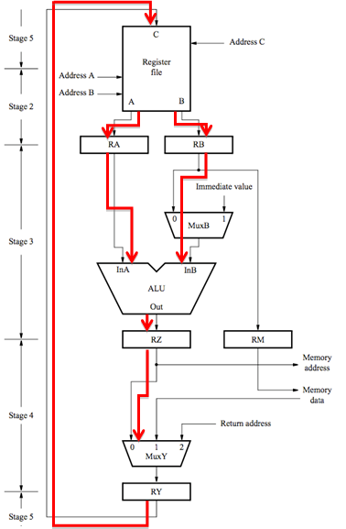
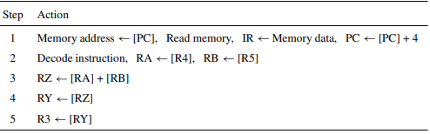
Hardware Components: DataPath
Datapath in a processor
Sequence of actions needed
to fetch and execute the instruction:
Add R3, R4, R5.

Slide 21
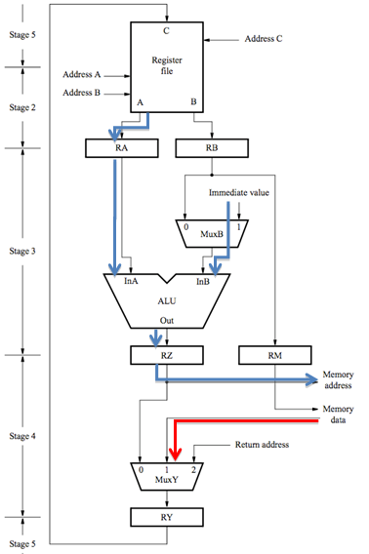
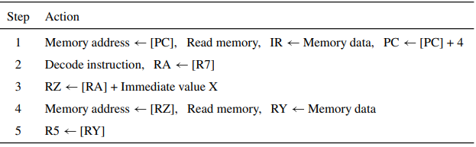
Hardware Components: DataPath
Datapath in a processor
Sequence of actions needed to
fetch and execute the instruction:
Load R5, X(R7).

Slide 22
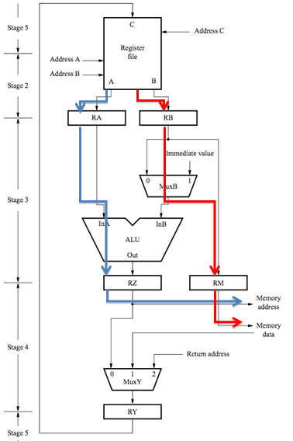
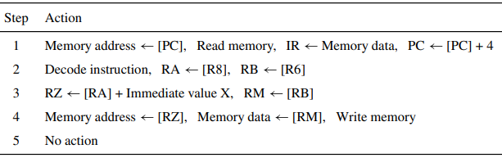
Hardware Components: DataPath
Datapath in a processor
Sequence of actions needed to
fetch and execute the instruction:
Store R6, X(R8).

Slide 23
Five-step sequence of actions to fetch and execute an instruction.
A five-step sequence of actions to fetch and execute an instruction.

Slide 24
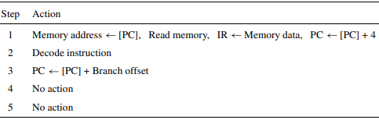
Hardware Components: DataPath
Datapath in a processor
Sequence of actions needed to
fetch and execute the instruction:
Unconditional Branch Instruction

Slide 25
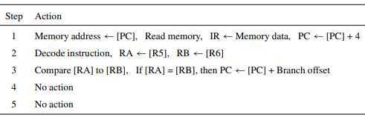
Hardware Components: DataPath
Datapath in a processor
Sequence of actions needed to
fetch and execute the instruction:
Conditional Branch Instruction
Branch_if_[R5]=[R6] LOOP

Slide 26
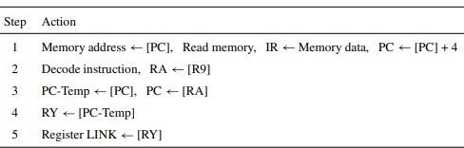
Hardware Components: DataPath
Datapath in a processor
Sequence of actions needed to
fetch and execute the instruction:
Subroutine Call Instructions
Call_Register R9
which calls a subroutine whose address
is in register R9

Slide 27
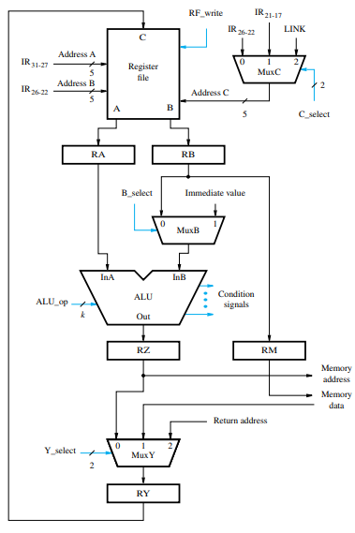
Control Signals
Select multiplexer inputs to guide the flow of data.
Set the function performed by the ALU.
Determine when data are written into the PC, the IR, the register file, and the memory.
Inter-stage registers are always enabled because their contents are only relevant in the cycles for which the stages connected to the register outputs are active.
Control signals for the datapath

Slide 28
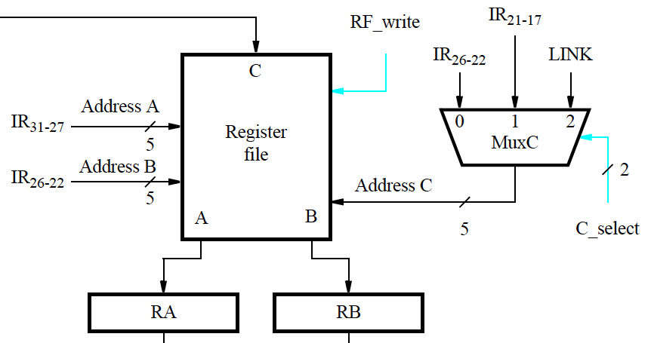
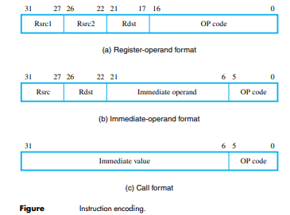
Rough Slide: to Explain Control Signals
Register File Control Signals

Slide 29
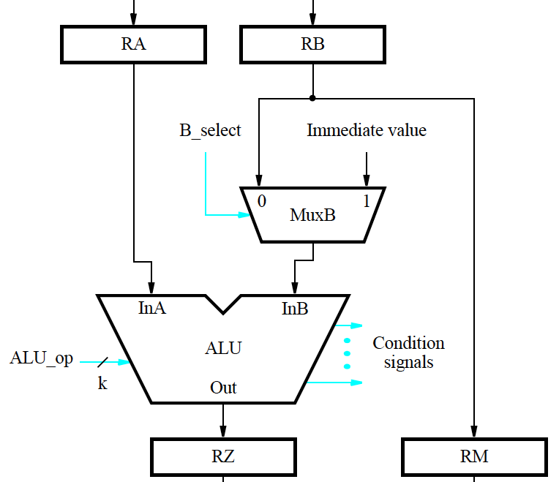
Rough Slide: to Explain Control Signals
ALU Control Signals

Slide 30
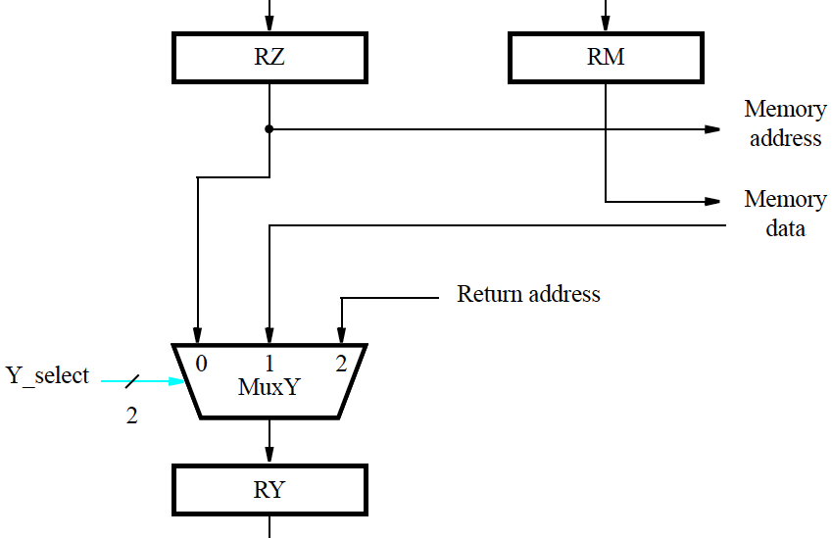
Rough Slide: to Explain Control Signals
Result Selection Signals

Slide 31
Control signal generation:
Actions to fetch & execute instructions have been described.
The necessary control signals have also been described.
Circuitry must be implemented to generate control signals so actions take place in correct sequence and at correct time.
There are two basic approaches: Hardwired control and Microprogramming

Slide 32
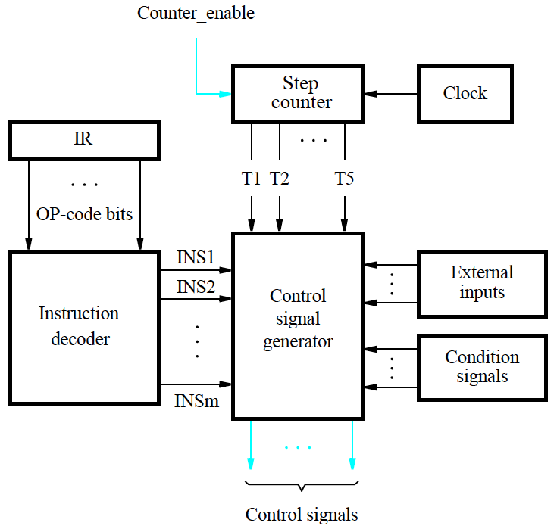
Hardwired Control
Hardwired control involves implementing circuitry that considers step counter, IR, ALU result, and external inputs.
Step counter keeps track of execution progress, one clock cycle for each of the five steps described earlier (unless a memory access takes longer than one cycle).
Generation of the control signals.

Slide 33
Parallel Computer Architecture
Parallel Computer Architecture: Processor Architecture and Technology Trends, Flynn’s Taxonomy of Parallel Architectures, Memory Organization of Parallel Computers: Computers with Distributed Memory Organization, Computers with Shared Memory Organization,
Thread-Level Parallelism: Simultaneous Multithreading, Multicore Processors

Slide 34
What is Parallel Computing ?
Serial vs Parallel Computing

Slide 35
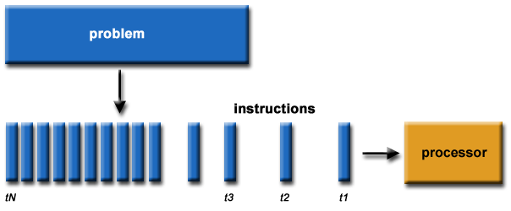
Serial Computing
Traditionally, software has been written for serial computation: A problem is broken into a discrete series of instructions
Instructions are executed sequentially one after another
Executed on a single processor
Only one instruction may execute at any moment in time

Slide 36
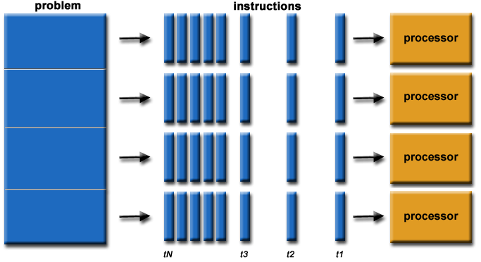
Parallel Computing
In the simplest sense, parallel computing is the simultaneous use of multiple compute resources to solve a computational problem: A problem is broken into discrete parts that can be solved concurrently
Each part is further broken down to a series of instructions
Instructions from each part execute simultaneously on different processors
An overall control/coordination mechanism is employed

Slide 37
Internal Parallelism Levels
Question:
List and Explain different levels of Internal Parallelism ?

Slide 38
Internal Parallelism Levels
1. Bit level parallelism
2. Parallelism by pipelining
3. Parallelism by multiple functional units
4. Parallelism at process or thread level

Slide 39
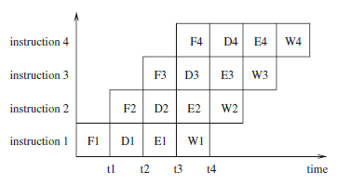
Internal Parallelism Levels
1. Bit level parallelism: 1970 to ~1985
4 bits, 8 bit, 16 bit, 32, 64 bit microprocessors
2. Parallelism by pipelining: ~1985 through today
Instruction level parallelism (ILP): The idea of pipelining at instruction level is an overlapping of the execution of multiple instructions.
The execution of each instruction is partitioned into several steps which are performed by dedicated hardware units (pipeline stages) one after another. A typical partitioning could result in the following steps:
(a) fetch: fetch the next instruction to be executed from memory;
(b) decode: decode the instruction fetched in step (a);
(c) execute: load the operands specified and execute the instruction;
(d) write-back: write the result into the target register/memory.

Slide 40
Internal Parallelism Levels (Contd…)
3. Parallelism by multiple functional units:
Many processors are multiple-issue processors.
They use multiple, independent functional units like ALUs (arithmetic logical units), FPUs (floating-point units), load/store units, or branch units.
These units can work in parallel, i.e., different independent instructions can be executed in parallel by different functional units. Thus, the average execution rate of instructions can be increased.
4. Parallelism at process or thread level:
The three techniques described so far assume a single sequential control flow which is provided by the compiler and which determines the execution order if there are dependencies between instructions.
An alternative approach is to use add multiple, independent processor cores onto a single processor chip.
This approach has been used for typical desktop processors since 2005. The resulting processor chips are called multicore processors. Example: Dual Core, Quadcore processor

Slide 41
Flynn’s Taxonomy of Parallel Computers
Question:
List and Explain different classifications of Parallel Computer according to Flynn’s Taxonomy ?

Slide 42
Flynn’s Taxonomy of Parallel Computers
Flynn’s Taxonomy: Classification according to important characteristics of a parallel computer.
Four categories are distinguished based on:
How Many Instruction Streams
How Many Data Streams
Single-Instruction, Single-Data (SISD)
Multiple-Instruction, Single-Data (MISD)
Single-Instruction, Multiple-Data (SIMD)
Multiple-Instruction, Multiple-Data (MIMD)

Slide 43
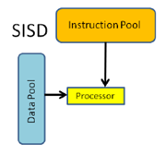
Flynn’s Taxonomy of Parallel Computers
Flynn’s Taxonomy: Classification according to important characteristics of a parallel computer.
Four categories are distinguished based on:
How Many Instruction Streams
How Many Data Streams
Single-Instruction, Single-Data (SISD)
Multiple-Instruction, Single-Data (MISD)
Single-Instruction, Multiple-Data (SIMD)
Multiple-Instruction, Multiple-Data (MIMD)
 | Instruction Stream | Data Stream
SSID | 1 | 1
MISD
SIMD
MIMD

Slide 44
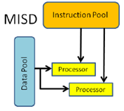
Flynn’s Taxonomy of Parallel Computers
Flynn’s Taxonomy: Classification according to important characteristics of a parallel computer.
Four categories are distinguished based on:
How Many Instruction Streams
How Many Data Streams
Single-Instruction, Single-Data (SISD)
Multiple-Instruction, Single-Data (MISD)
Single-Instruction, Multiple-Data (SIMD)
Multiple-Instruction, Multiple-Data (MIMD)
 | Instruction Stream | Data Stream
SSID | 1 | 1
MISD | >1 | 1
SIMD
MIMD

Slide 45
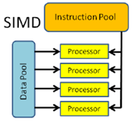
Flynn’s Taxonomy of Parallel Computers
Flynn’s Taxonomy: Classification according to important characteristics of a parallel computer.
Four categories are distinguished based on:
How Many Instruction Streams
How Many Data Streams
Single-Instruction, Single-Data (SISD)
Multiple-Instruction, Single-Data (MISD)
Single-Instruction, Multiple-Data (SIMD)
Multiple-Instruction, Multiple-Data (MIMD)
 | Instruction Stream | Data Stream
SSID | 1 | 1
MISD | >1 | 1
SIMD | 1 | >1
MIMD

Slide 46
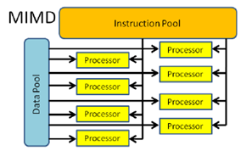
Flynn’s Taxonomy of Parallel Computers
Flynn’s Taxonomy: Classification according to important characteristics of a parallel computer.
Four categories are distinguished based on:
How Many Instruction Streams
How Many Data Streams
Single-Instruction, Single-Data (SISD)
Multiple-Instruction, Single-Data (MISD)
Single-Instruction, Multiple-Data (SIMD)
Multiple-Instruction, Multiple-Data (MIMD)
 | Instruction Stream | Data Stream
SSID | 1 | 1
MISD | >1 | 1
SIMD | 1 | >1
MIMD | >1 | >1

Slide 47
Flynn’s Taxonomy of Parallel Computers (Contd…)
1. Single-Instruction, Single-Data (SISD): There is one processing element which has access to a single program and data storage. In each step, the processing element loads an instruction and the corresponding data and executes the instruction. The result is stored back in the data storage. Thus, SISD is the conventional sequential computer according to the von Neumann model.
2. Multiple-Instruction, Single-Data (MISD): There are multiple processing elements each of which has a private program memory, but there is only one common access to a single global data memory. In each step, each processing element obtains the same data element from the data memory and loads an instruction from its private program memory. These possibly different instructions are then executed in parallel by the processing elements using the previously obtained (identical) data element as operand. This execution model is very restrictive and no commercial parallel computer of this type has ever been built.

Slide 48
Flynn’s Taxonomy of Parallel Computers (Contd…)
3. Single-Instruction, Multiple-Data (SIMD): There are multiple processing elements each of which has a private access to a (shared or distributed) data memory. But there is only one program memory from which a special control processor fetches and dispatches instructions. In each step, each processing element obtains from the control processor the same instruction and loads a separate data element through its private data access on which the instruction is performed. Thus, the instruction
is synchronously applied in parallel by all processing elements to different data elements.
For applications with a significant degree of data parallelism, the SIMD approach can be very efficient. Examples are multimedia applications or computer graphics algorithms to generate realistic three-dimensional views of computer-generated environments.
4. Multiple-Instruction, Multiple-Data (MIMD): There are multiple processing elements each of which has a separate instruction and data access to a (shared or distributed) program and data memory. In each step, each processing element loads a separate instruction and a separate data element, applies the instruction to the data element, and stores a possible result back into the data storage. The processing elements work asynchronously with each other. Multicore processors or cluster systems are examples for the MIMD model.

Slide 49
Memory Organization of Parallel Computers
A Further classification of MIMD computers can be done according to their memory organization:
1. Computers with Distributed Memory Organization
2. Computers with Shared Memory Organization

Slide 50
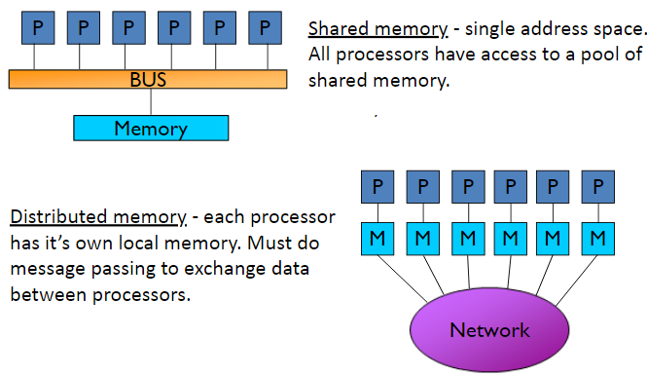
Shared vs. Distributed Memory
The simplest and most useful way to classify modern parallel computers is by their memory model:
Shared memory and Distributed memory

Slide 51
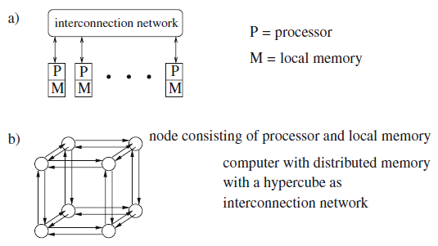
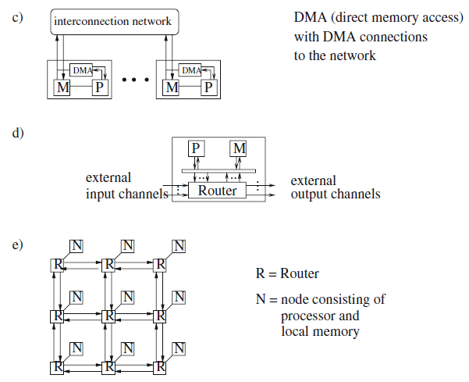
Illustration of computers with distributed memory
Illustration of computers with distributed memory: (a) abstract structure,
(b) computer with distributed memory and hypercube as interconnection structure,
(c) DMA (direct memory access), (d) processor–memory node with router, and (e) interconnection network in the form of a mesh to connect the routers of the different processor–memory nodes

Slide 52
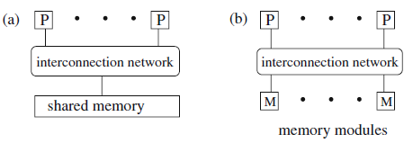
Illustration of a computer with shared memory
Illustration of a computer with shared memory: (a) abstract view and (b) implementation of the shared memory with memory modules

Slide 53
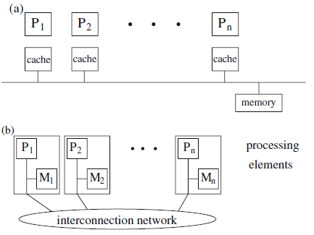
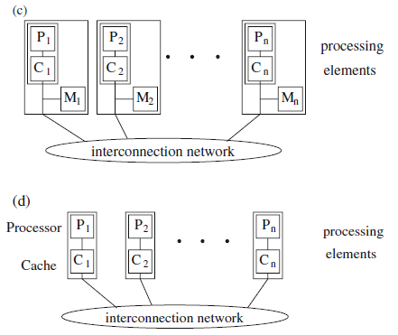
Illustration of the architecture of computers with shared memory:
Illustration of the architecture of computers with shared memory: (a) SMP – symmetric multiprocessors, (b) NUMA – non-uniform memory access, (c) CC-NUMA – cache-coherent NUMA, and (d) COMA – cache-only memory access

Slide 54
Thread-Level Parallelism

Slide 55
What is Thread w.r.t Computers ?
Thread: A Process (or Program) with own instructions and data
- Each thread has all the state (instructions, data, PC, register state, and so on) necessary to allow it to execute

Slide 56
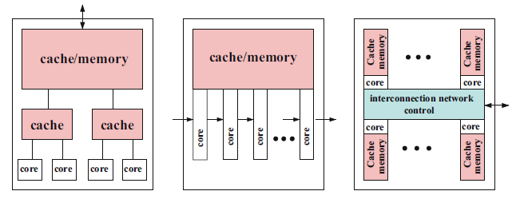
Thread-Level Parallelism
Multi-Core Processors: Placement of multiple independent execution cores with all execution resources onto a single processor chip.
Design choices for multicore chips
Hierarchical design

Slide 57
Thread-Level Parallelism
Multi-Core Processors: Placement of multiple independent execution cores with all execution resources onto a single processor chip.
Design choices for multicore chips
Hierarchical design
Pipelined design

Slide 58
Thread-Level Parallelism
Multi-Core Processors: Placement of multiple independent execution cores with all execution resources onto a single processor chip.
Design choices for multicore chips
Hierarchical design
Pipelined design
Network-based design

Slide 59
Thanks for Listening

